Slide 1
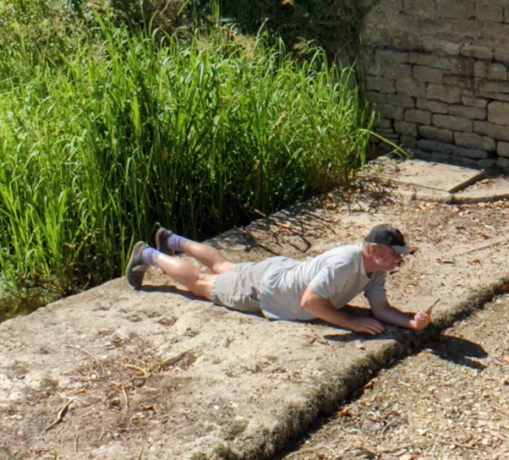


Friends of the Gumstool Brook - Open Meeting
The dry spring of 2026:
What next?
Open Meeting
Corinium Museum
8th June 2026
Dr Mike Jones
@GroundwaterMike
Friends of the Gumstool Brook

Slide 2
Rainfall in the Churn catchment
Churn rainfall in 2025 was ~870 mm, around average, combining a wet Autumn/Winter with the 3rd driest Spring/Summer on record
Above average rainfall continued from September 2025 to February 2026, resulting in the wettest Autumn/Winter on record
The pattern of wet Autumn/Winter followed by a dry Spring is being repeated with below average Spring rainfall in 2026
What Summer weather can we expect?
Met Office UK-wide outlook for June to August suggests near average rainfall is most likely with a higher than normal chance of hot weather
Temporary Use Ban was in place from July to November 2025, but no suggestion yet of one being needed in 2026
Above average
Above average
Below average
Notes:
2024 = Wettest calendar year in 42 year record
2023/24 = Wettest water year on record
2025 = 14th wettest in on record
2024/25 = 15th wettest in on record
2023/24 Autumn/Winter = 2nd wettest on record
2024/25 Autumn/Winter = 6th wettest on record
2025/26 Autumn/Winter = Wettest on record

Slide 3
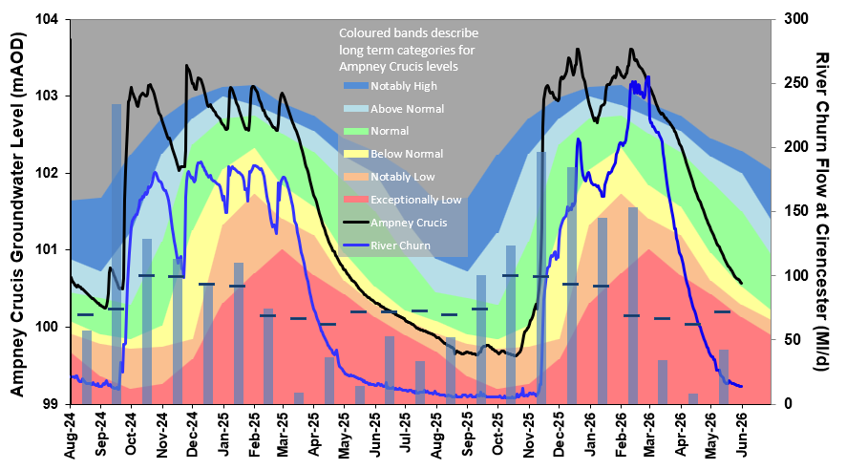
Groundwater & River Churn response
Periods of exceptionally high groundwater levels in 2025/26 Autumn/Winter
Below average Spring rainfall caused levels to fall but remain normal so far
End May 2026 groundwater levels in the limestone and gravel aquifers are slightly higher compared with 2025
With groundwater flow out of aquifers supporting river flow, the pattern of River Churn flow is similar to groundwater levels
River flow is exceptionally low for the time of year, similar to 2025
As a result, groundwater pumping at Baunton for public water supply has stopped

Slide 4
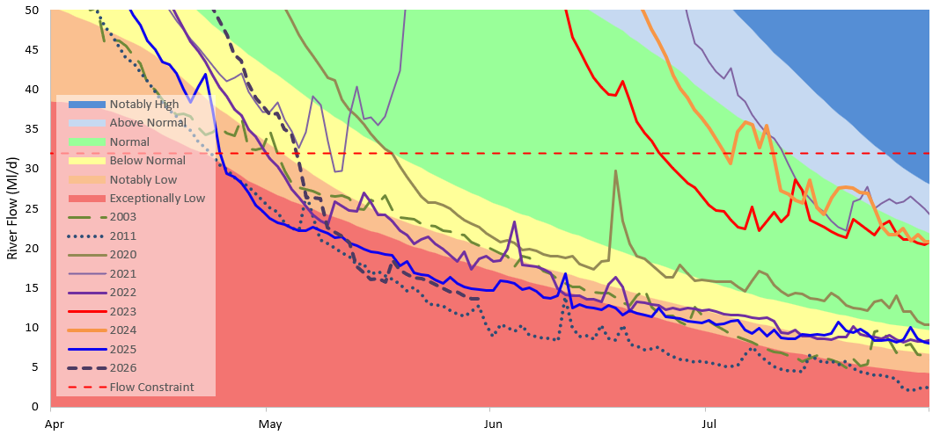
How low are river flows in the Churn this Spring?
Low flow years from 21st century illustrate variability in flows:
2020: below normal
2022: notably low
2025 & 2026: exceptionally low 3rd & 2nd lowest on record
2011: exceptionally low with lowest Spring flows on record
Considering subsequent Summer/Autumn flows:
2003: below normal in Spring, but in September the Churn dried up north of Cirencester
2025: exceptionally low in Spring, but below normal from mid-Summer
Forecasting Summer/Autumn low flows is not simple
Colour bandings defined to be consistent with EA approach
Notes:
Return Periods
End May 2026 flow has a return period of 1:35 years.
In the 45 year flow record, the chance of this end May flow occurring is 73%.
It’s occurred twice; 2025 & 2026
End May 2011 flow has a return period of 1:50 years.
In the 45 year flow record, the chance of this end May flow occurring is 60%.
Return period of 1:100 for annual minimum flow has a 36% chance of occurring in the 45 year flow record
This flow approximates to what occurred in 1995 and 2003
SMD
End May SMD was slightly greater in 2025 (57-68 mm), compared with 2026 (55 mm). Both well below the LTA

Slide 5
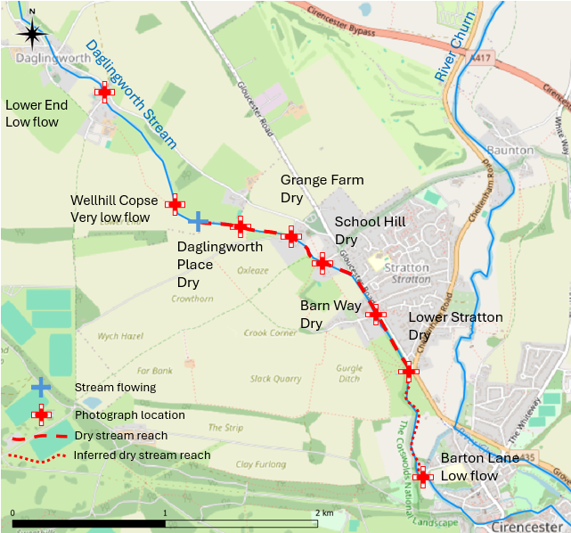
Water environment impacts – Daglingworth Stream
Daglingworth Stream headwaters flow continuously in Duntisbourne Abbots, but the stream dries up regularly in its lower reaches
At the end of May 2026, the stream stopped flowing upstream of Daglingworth Place, just over 2 km upstream of Cirencester
At end October 2025, ~4 km of the stream was dry, extending upstream to Daglingworth; the longest length of dry stream recorded by FoGB
How much more of the Daglingworth Stream could dry up this Summer and Autumn?
This will depend largely on how much further groundwater levels fall and when Autumn rainfall causes levels to rise again
Barton Mill Pound
August 2022

Slide 6
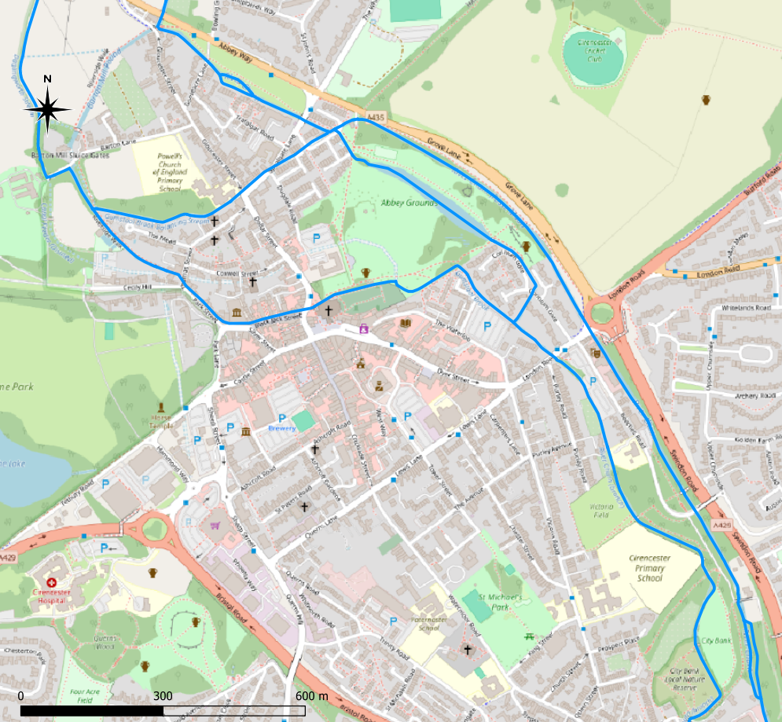
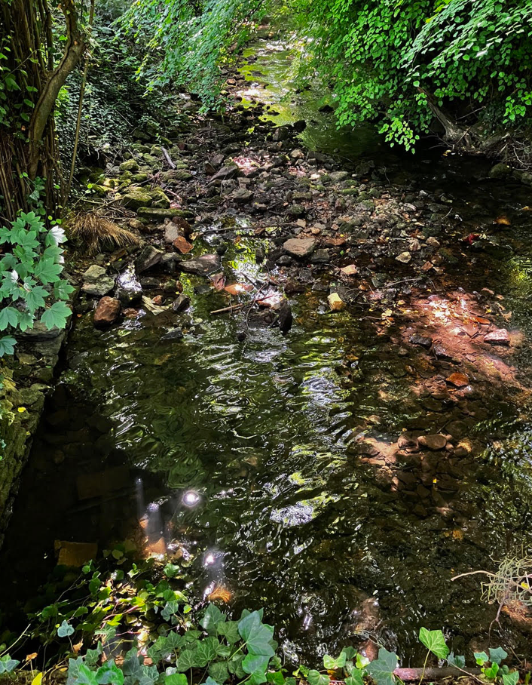
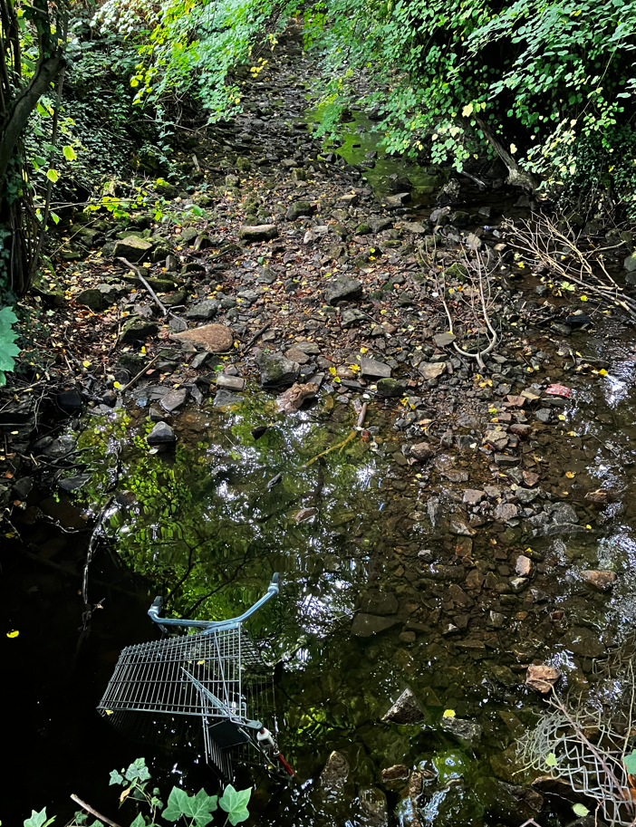
Water environment impacts – Churn & Gumstool Brook
At the end of May, flow through Barton Mill Pound & Gumstool Brook was very low
Dense vegetation in the Gumstool Brook channel, encouraged by hot weather
Eastern branch of the Churn at New Mills had low, shallow flows with its bed partly dried up
Groundwater levels are below river bed level, so river water may leak into the gravel aquifer
What could happen this Summer and Autumn?
Not uncommon for Barton Mill Pound & Gumstool Brook to have low flow, ponded water & dry sections, as in summer 2025
Eastern Churn was largely dry with ponded water in August & Sept 2025, despite the total Churn flow being below normal and not exceptionally low
Barton Mill Pound
Barton Mill Pound
Balancing Stream
Gumstool Brook
Gumstool Brook
River Churn, New Mills
River Churn, New Mills
August 2022
Churn – West Branch
Churn – East Branch
May 2026
August 2025

Slide 7
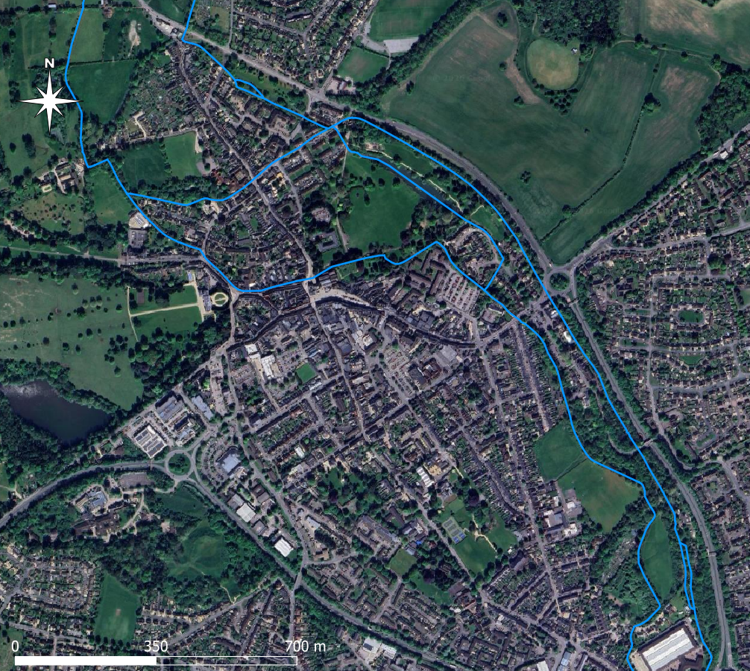
What next?
Gloucester St sluices
Potential for low flow management
Weather
Average rainfall would mitigate risk of ecological impact in Cirencester’s waterways
Hot weather could increase the risk
Monitoring
Need enhanced monitoring to help understand waterways response to water stress
Interventions
Medium term: Environmental enhancements to improve resilience to dry weather & low flows
Long term: Infrastructure enhancements to enable improvements in low river flow management
Barton Mill Pound
Jack Gardners
Barton Mill Pound
Hereward Road
Channel junction
Hereward Road
Abbey Grounds
Gumstool Brook
Daglingworth Stream
River Churn – East Branch
August 2022
River Churn – West Branch
In-channel enhancements
Shade reduction & overgrowth management
City Bank

Slide 8
Thank you. Any questions?
If you are interested in joining the Friends of the Gumstool Brook, you can contact us on FriendsOfGumstoolBrook@gmail.com

