Slide 1
Version 22.05.26
FoGB
Deterioration in Water Quality?
A Reflection
Notes:
Version 22.0526

Slide 2
Water Quality is a complex issue,
thanks to colleagues esp NE and MJ for explaining these complexities
We think of:
- Pollution, eg Nitrates/No3 , phosphates pH , etc
-Eutrophication (Greek = Well nourished). .
-increased growth of organisms /algal blooms,
-oxygen depletion,
-decreased biodiversity. …
Notes:
Water Quality is a complex issue.
Includes …Pollution, N/No3 , Eutrophication (Greek = Well nourished). . increased growth of organisms /algal blooms, and oxygen depletion, decreased biodiversity.

Slide 3
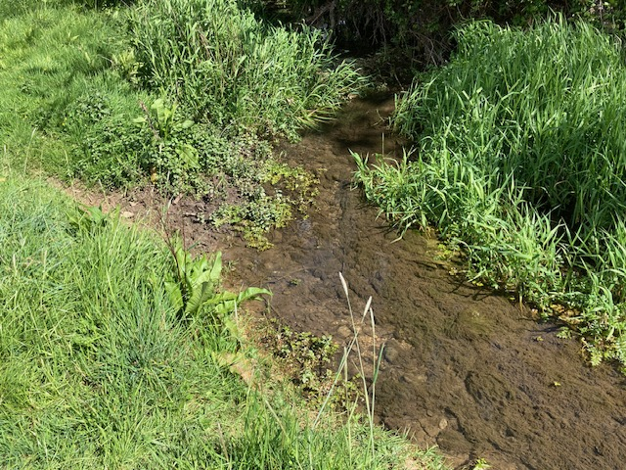
Recall the “good old days”.
-Big trout in Daglingworth stream by Ciren Park entrance in Barton Lane
-Sticklebacks swarming to breed in gravel beds on the Churn on Stratton meadows, which now looks very different.
Notes:
We all observe, and compare and recall the good old days.
Big trout in Daglingworth stream by Ciren Park entrance in Barton Lane, Sticklebacks swarming to breed I gravel beds on the Churn on Stratton meadows.PHOTO

Slide 4
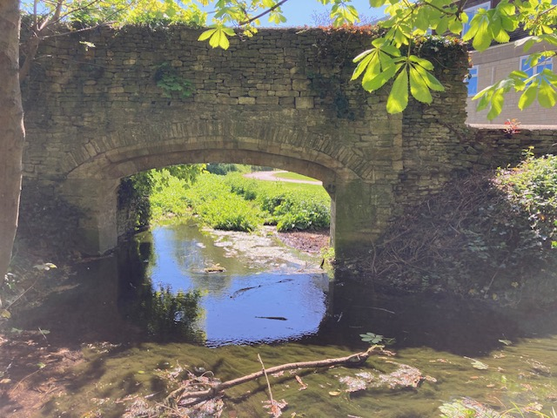
29th April 2026 - Churn Sociable stroll – Gumstool Brook looked polluted.
Abbey Grounds Arch
Notes:
29th April 2026 Churn Sociable stroll – Gumstool Brook polluted?

Slide 5
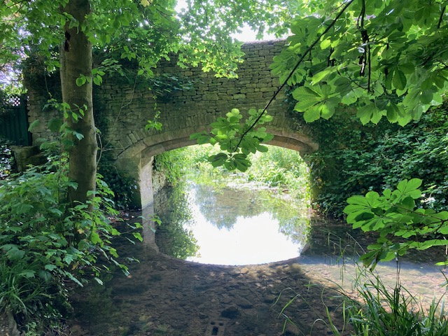
Compare with June 2024
Expect more growth in June – but not the case
Notes:
June 2024

Slide 6
By chance…4 days earlier – several FoGB took part in FreshWater Watch (FWW) by Earthwatch
- Water Blitz Pollution survey
- from Baunton to Siddington
Obvious question…what did the 6 samples taken on 25th April Water Blitz sampling show??…
Notes:
Obvious question…what did the 6 samples taken in 25th April Water Blitz sampling show??…Baunton to Siddington

Slide 7
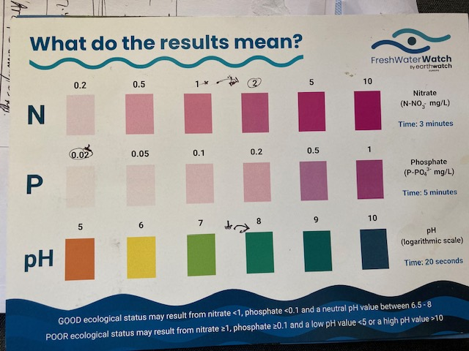
WaterBlitz method include using a:
Colour matching chart
Measuring Nitrates , Phosphates and pH
Notes:
WBlitz method involved Colour matching…chart pH , phosphates and nitratesPHOTO

Slide 8
RESULTS OF WaterBlitz sampling:
1. All Phosphate sample levels low, and pH normal.
All 6 Nitrate levels “moderate” concentrations as classified by FWW
(Nitrogen levels expressed here as just Nitrogen (N-No3) as 1-2 mg/L,
or if expressed as nitrate ion NO3, would be = 4.4 – 8.8 mg/l )
Notes:
All Phosphate sample levels low
All 6 Nitrate levels moderate concentrations as classified by FWW (Nitrogen levels expressed as
N-No3) as 1-2 mg/L, or as nitrate ion NO3 = 4.4 – 8.8 mg/l )

Slide 9
FWW info shows they regard 10mg/L as the N conc that represents pollution in rivers .
So local FWW samples only 1/5 or less than “Pollution Level “
In theory, could calculate weight of nitrate added to Churn
upstream.
Note – another more scientific sampling method showed low N – colour matching is known to be problematical. So probably even less than 1/5th of “polluted “ level.
Notes:
FWW info shows they regard 10mg/L as the N conc that represents pollution in rivers . So local FWW samples only 1/5 or less than that level.

Slide 10
-There is no formal regulatory standard in England for N conc in rivers.
-There is a standard to protect drinking water to taps, NO3 is over 50 mg/L , or N-NO3 = 11.3 mg/L
-NPPR (Nitrate Pollution Prevention Regs) considers water body polluted if NO3 is over 50 mg/L , or N-NO3 = 11.3 mg/L
-So even the “moderate “readings around 1-2 mg/L of N-No3 were only between 10% and 20% at most of this NPPR “polluted” definition.
Notes:
there is no formal regulatory standard in England for N conc in rivers.
There is a standard to protect drinking water to taps,
NPPR (N Pollution Prevention Regs considers water body polluted if NO3 is over 50 mg/L , or N-NO3 = 11.3 mg/L So even the “moderate “readings around 1-2 mg/L of N-No3 were between 10% and 20% at most of this “polluted” definition.

Slide 11
NPPR regs introduce the concept of NVZ – Nitrate Vulnerable Zones.
In these NVZs rules about application and storage of nitrogen fertiliser and organic manure
are to be followed.
The Upper Churn valley is designated as an NVZ by DEFRA, and Landowners can appeal during 2025-2028.
Grassland derogation applications to increase N limits can be made.
Many EU countries have made all areas NVZ
Notes:
NPPR regs introduce the concept of NVZ – Nitrate Vulnerable Zones. In these certain farming practices are recommended. Upper Churn valley not a NVZ.
Many EU countries have made all areas NVZ

Slide 12
Nitrate Vulnerable Zones (NVZs): The NPPR 2015 requires farmers in designated areas to follow mandatory action programmes to reduce nitrogen pollution in water.
Post-Implementation Review (2025): The 2015 regulations underwent a review in March 2025, which received a green rating for its assessment of the rules' effectiveness.
Water (Special Measures) Act 2025: Effective from June 23, 2025, this law forces water companies to publish yearly Pollution Incident Reduction Plans (PIRPs) to reduce sewage pollution.
Nutrient Neutrality: To mitigate excess nutrients in protected sites, new developments in certain areas must achieve nutrient neutrality, supported by a new Nutrient Mitigation Scheme.
Regulation 4: Ensures all water fittings (taps, toilets) connected to the public supply are tested for safety and compliance.
Water Resource Challenges: Concerns about future water availability have spurred plans for new infrastructure to prevent scarcity, with 2025 frameworks highlighting the need to protect the water environment
Notes:
Nitrate Vulnerable Zones (NVZs): The NPPR 2015 requires farmers in designated areas to follow mandatory action programmes to reduce nitrogen pollution in water.
Post-Implementation Review (2025): The 2015 regulations underwent a review in March 2025, which received a green rating for its assessment of the rules' effectiveness.
Water (Special Measures) Act 2025: Effective from June 23, 2025, this law forces water companies to publish yearly Pollution Incident Reduction Plans (PIRPs) to reduce sewage pollution.
Nutrient Neutrality: To mitigate excess nutrients in protected sites, new developments in certain areas must achieve nutrient neutrality, supported by a new Nutrient Mitigation Scheme.
Regulation 4: Ensures all water fittings (taps, toilets) connected to the public supply are tested for safety and compliance.
Water Resource Challenges: Concerns about future water availability have spurred plans for new infrastructure to prevent scarcity, with 2025 frameworks highlighting the need to protect the water environment

