Slide 1

FoGB Monthly monitoring report
Andy Sworn
11th June 2026

Slide 2
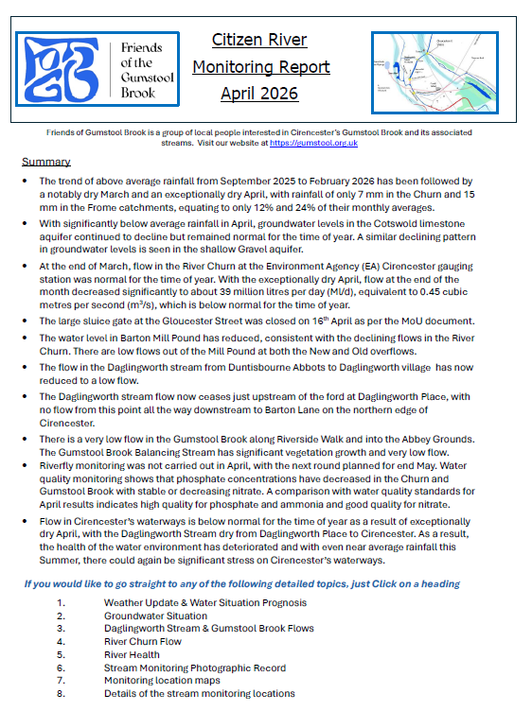
Each month a fogb citizen volunteer team collect and collate data for the local Cirencester water ways
Contents
1 Page Summary
Weather Update
Groundwater Situation
River Churn Flow
River Health
Stream Monitoring Photographic Record
Monitoring Locations Maps
Details of Stream Monitoring Locations
It’s published on the FoGB website -
WWW.gumstool.org.uk and also distributed by email

