Slide 1
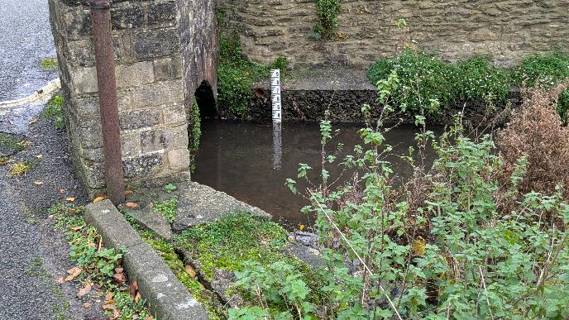

FoGB Continuous River Level Monitoring Project
Neil Edwards
FOGB
With grateful thanks to:
Mike Edwards (Helix)
Mike Jones (FoGB)
John Tiffney (FoGB)
Jos Jeapes (Cloud RF)
FoGB Open Meeting
8th June 2026
V3 June 2026

Slide 2
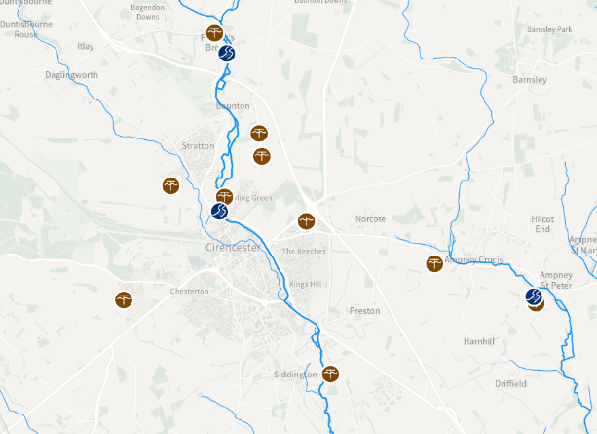
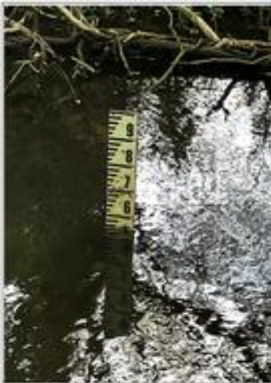
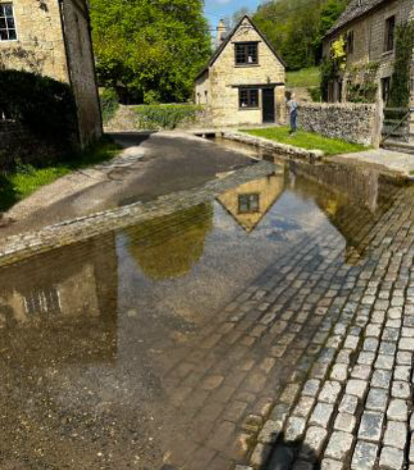
Why additional monitoring ?
Limited existing relevant high frequency monitoring with no monitoring of smaller watercourses in and around Cirencester
  Environment Agency flow gauging on R.Churn
  Environment Agency borehole gauging of groundwater and aquifers
Existing FoGB monthly monitoring is a useful resource for supporting qualitative understanding but not always easy to interpret quantitatively
  Photographic or human observation of fixed site ‘features’/guageboards
Low flow trial of 2025 highlighted some difficulties
  Low time resolution – generally hourly at best and very intensive on people
  No overnight observations – missed peaks?
  Subjectivity in reading dirty guageboards in varying lighting even off photos
Any future case-making to support improved management of flows will benefit from better data ideally of flows and levels e.g.
  To aid conceptual understanding of what’s happening now
  To calibrate and validate models of alternative flow management options in future flow regimes
Data/modelling likely to be necessary to support any future licence and permit applications

Slide 3
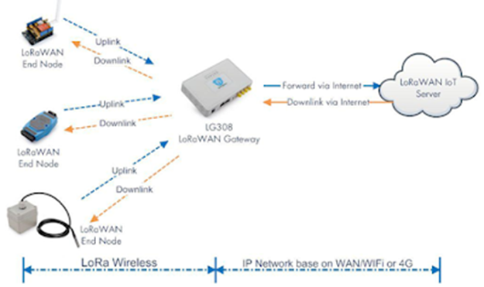
What is proposed?
Chat about the problems in the low flow trial monitoring with Mike Edwards(EEE MEng) on a stroll down Riverside Walk some months later
  Motivated investigating potential for Internet of Things (IoT) network of sensors using Long Range Wide Area Network (LoRaWAN) radio technology
‘End nodes’ are eg river level sensors
Communicate with a gateway using LoRaWAN
Gateway transmits data to a cloud-based server using normal internet
Users can interact with the server
Server can issue ‘alerts’ which can be basis of action or control

Slide 4

Why LoRaWAN technology for high frequency monitoring?
Proven in similar applications
  10 min small data packet transmission in ‘noisy’ urban areas
Data gathered to date are not lost if instrument damaged or stolen
Cheap (a few £hundred per instrument) and no cost for LoRaWAN
Several commercial suppliers of UK-frequency kit (868MHz), network servers etc
Easily scalable to a practical multi-sensor network
  1 gateway and server can service multiple instruments of different types
Potential for ease of maintenance
  Battery life 5-10 years typically
  But would need to check instrument in situ occasionally to ensure data are representative
Can extend network with sensors of determinands other than level e.g.
  Temperature
  Velocity (e.g. surface measurement using Doppler shift)
  Multipath flow (at significant additional cost) or use level at a weir of known characteristic
  Water quality (e.g. dissolved oxygen)

Slide 5
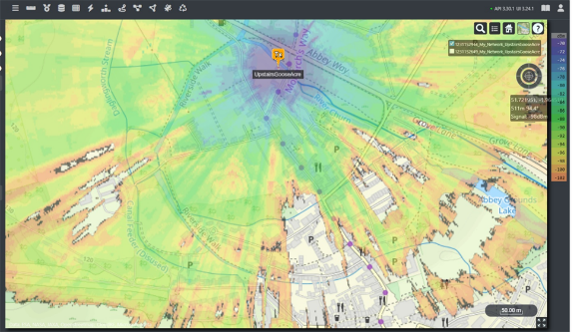
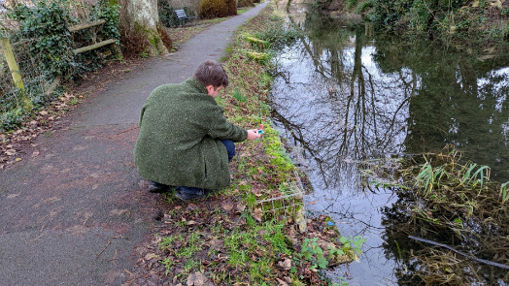
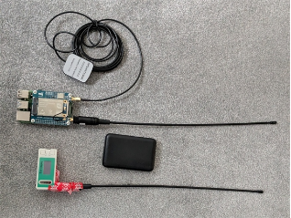
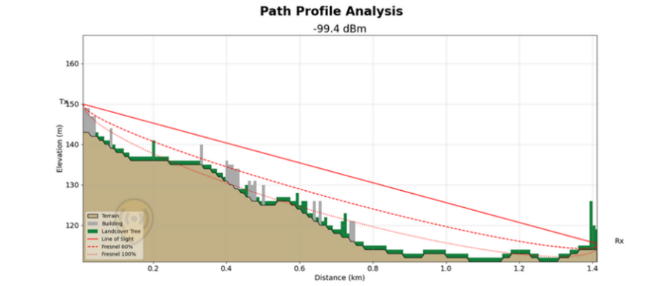
What have we done so far?
Nov 2025 - Initial desk-based assessment of potential using Cloud RF software and built in digital terrain model (5m resolution)
  Suggested signal strength would be acceptable
22nd Dec 2025 - initial field trials with home constructed emulator and receiver placed in Stratton Heights loft
  Could get useful signal at BMP Bend but patchy elsewhere on BMP and Churn
30th Dec 2025 - Field Trial with receiver in Gooseacre Lane upper room
  Good signal strength at Gloucester St, along BMP, Balancing Stream Sluice and at Spitalgate Bridge
  Failed at Swimming Pool Entrance and Thomas St Trash screen (Walls)
  Some careful placement of instruments to avoid local signal weakening likely to be necessary
    Walls, buildings, large trees etc – see Fresnel Zone indication in path analysis
FoGB Discussion Paper on options and indicative costs
Recommendation to trial 2 [3] different sensor technologies at Gooseacre Lane site
  radar technology is more expensive and LoRaWAN equipped instrument was not available in UK at time of original paper but is as of 1 Jun 2026!)
  Mounting options
    Avoidance of wall interference
    LoRaWAN signal strength
  Compare ultrasound v pressure sensor [v radar] technology performance in situ
  Practical accuracy/uncertainty (with nearby gauge board for ‘groundtruthing’)
  Development of ‘network’ dashboard for network condition monitoring
  Development of server routines for data download and alerts
  Development of data analysis routines

Slide 6
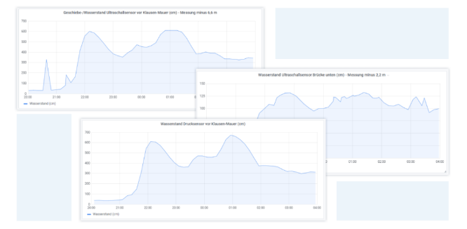
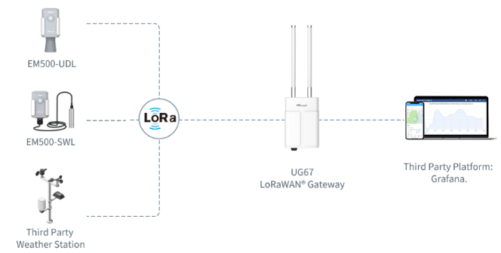
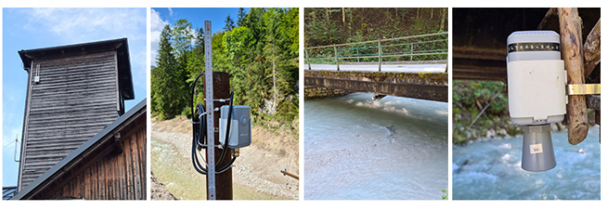
What evidence is there that it will work?
There are several examples of similar applications documented in the literature and on line.
Example – Real-time flood risk monitoring Weißenbach Valley (Austria)
10 min level data upstream and downstream of Chorinsky-Klause dam using ultrasound and pressure sensors
Has enabled monitoring of flood risk without visiting the remote dam served only by a small dirt road inaccessible in winter
Users can view water level and rainfall data in real-time.
Network condition is monitored through the device hub (or IoT Cloud)
Network server for analysis
Images from Milesight website library of ‘success stories’

Slide 7
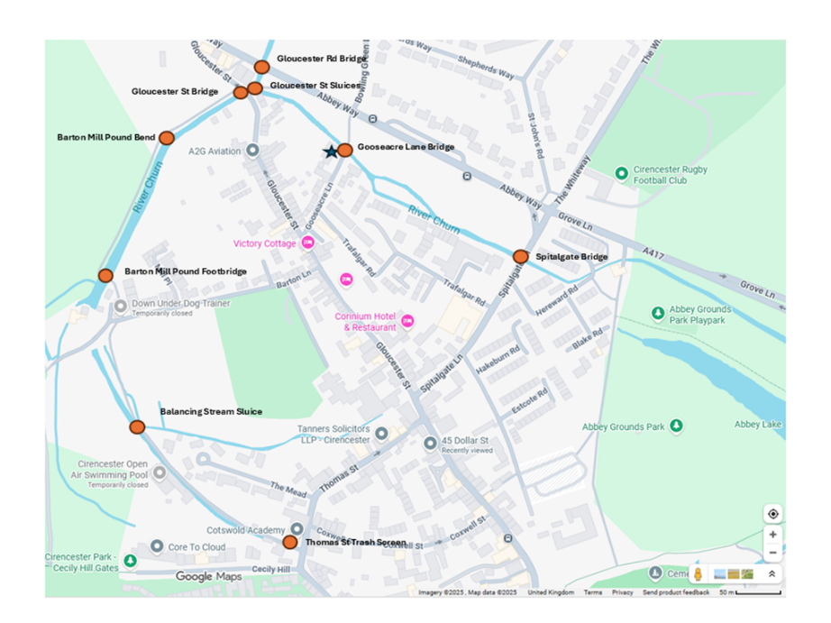
What next?
Learn lessons from the Gooseacre Lane sensor trial
  Would like to operate say July 2026 to Feb 2027 in low, normal and high flow conditions
Learn from what others are doing
Keep aware of new options
  Eg LoRaWAN-based radar sensor if not done in first trial
    potential for mm accuracy in level if that is is found useful
    Possibly for low flow management
Assess whether further trial is necessary
Possibly recommend options for moving towards practical network for priority locations if there is appetite/funding to do so
  Consider how any data would be used for real e.g.
    Model calibration/validation
    Condition or control alerts
    Promote awareness (e.g. display dashboards)
  …

Slide 8
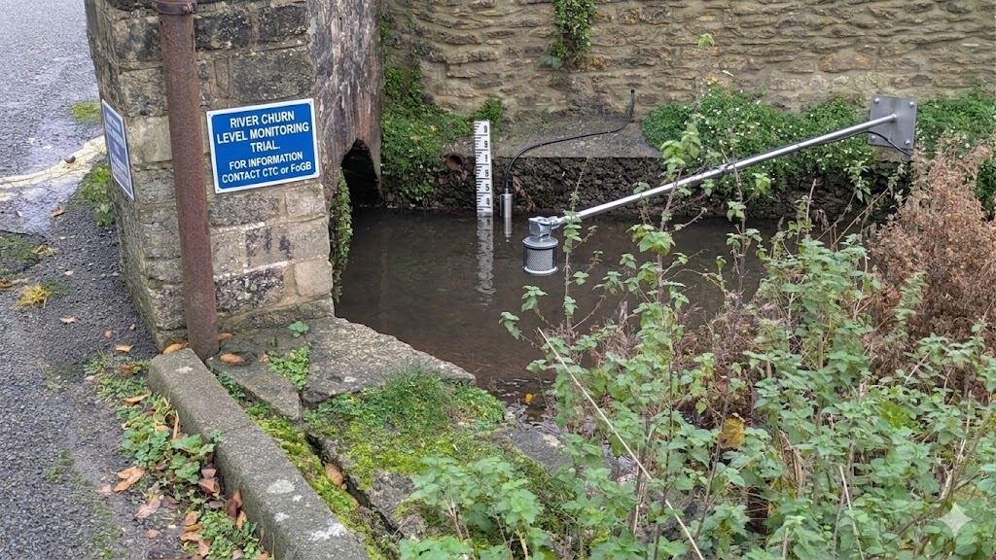
Thank You For Your Attention
Any questions?
Indicative AI generated image of possible trial arrangement showing ultrasound- and pressure-based sensors

