Slide 1
Cirencester Town Council Update
Friends of the Gumstool Brook Open Meeting
8th June 2026

Slide 2
Highlights…
Green Spaces Strategy and Climate and Environment Action Plan
NEIRF Project
Thames Water Grant Applications
Community Emergency Plan
Churn NFM Project – Community Engagement

Slide 3
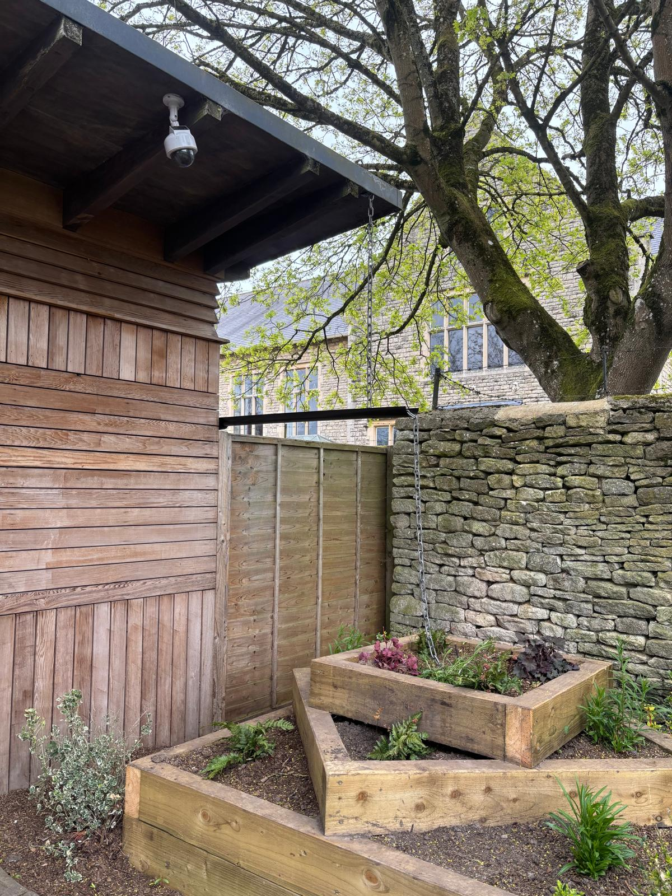
Green Spaces Strategy and Climate and Environment Action Plan
Aiming for a rain garden in every ward – suggested locations welcome!
GWT Waterscapes Project Inspiration
Thames Water application hitting a number of the Green Spaces Strategy items and actions
Big Lunch Water Spotlight = community engagement

Slide 4

The Natural Environment Investment Readiness Fund Project
CTC is proud to endorse the NEIRF Project
Led by FWAG and Jenny Phelps
??? Economic Value within Flood Zone 2 and 3 Downstream in Cirencester
NEIRF – Gloucestershire Green Investment Portfolio
Notes:
£816m - research thus far has found that a good way forward is funding a facilitator that can support and connect farmers and the community, who can lever in funding from multiple sources to facilitate nature based solutions upstream to minimise flood risk in town, through a business resilience group or something of the sort.

Slide 5
Thames Water Applications
£2,500 application submitted in partnership with Cirencester Wildlife Group for the Thames Water Community Fund for a ‘3 Pond Project’
£97,435.75 application submitted through CCWEP for the Thames Water Enhance the River Fund for Cirencester River Churn Corridor Enhancements.

Slide 6
Community Emergency Plan
Plans are in the pipeline to partner with GRCC and CDC on a Cirencester’s Community Emergency Plan

Slide 7
Churn NFM Project
Looking forward to working with GCC, GRCC and FWAG to map out the community engagement in Cirencester for the Churn NFM project

