Slide 1
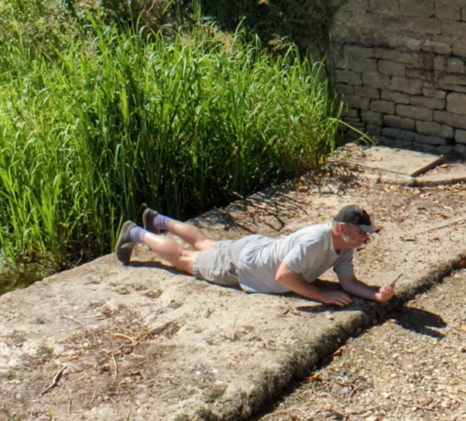


Friends of the Gumstool Brook - Open Meeting
The dry summer of 2025:
What next?
Open Meeting
Corinium Museum
27th November 2025
Dr Mike Jones
@GroundwaterMike
Friends of the Gumstool Brook

Slide 2
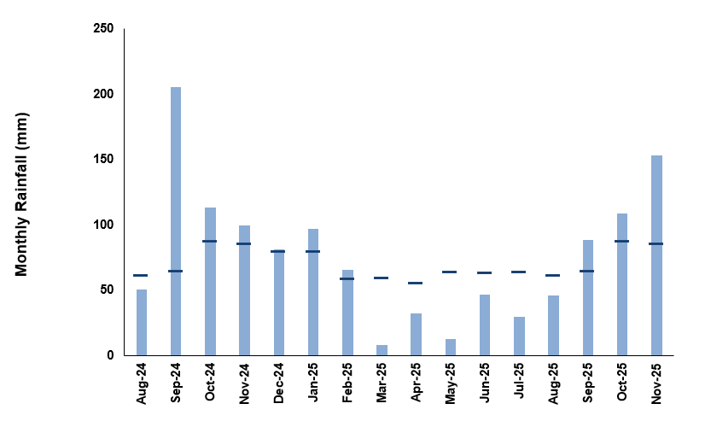
Rainfall in the Churn catchment
Churn average annual rainfall ~900 mm
Churn 2024 actual rainfall = 1300 to 1400 mm the wettest calendar year on record
Above average rainfall continued in January & February 2025, then the weather changed
From March through to August, there was 6 months of below average rainfall
Described as a period of prolonged dry weather, it led to a Temporary Use Ban by Thames Water starting on 22nd July
Autumn has been wetter so far, but what winter weather can we expect?
Met Office UK-wide outlook for Nov ‘25 to Jan ‘26 indicated a higher than normal chance of dry weather with uncertain regional rainfall variations
Next Met Office 3 month outlook due on 1st December
Above average
Below average

Slide 3
Groundwater & River Churn response
Periods of exceptionally & notably high groundwater levels in 2024/25 autumn & winter
Below average spring rainfall caused fall to notably low levels
Pattern of River Churn flow is very similar; groundwater flow out of aquifers drives river flow
What happened after the dry summer?
Wet September & October, but soils not sufficiently wet to allow aquifer recharge, nor river flow to increase
Even wetter November (150-170% of LTA) has had an impact

Slide 4
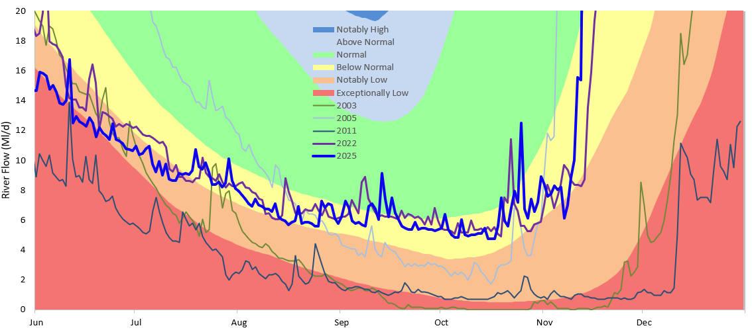
How dry was this summer? Low river flows
Review of 21st century low flow years suggests that summer 2025 & 2022 were not that extreme
Provisional definition of colour bandings, consistent with EA approach, helps visualisation
2022 & 2025: below normal
2005: notably low
2011: mostly exceptionally low
2003: dry at gauging station

Slide 5
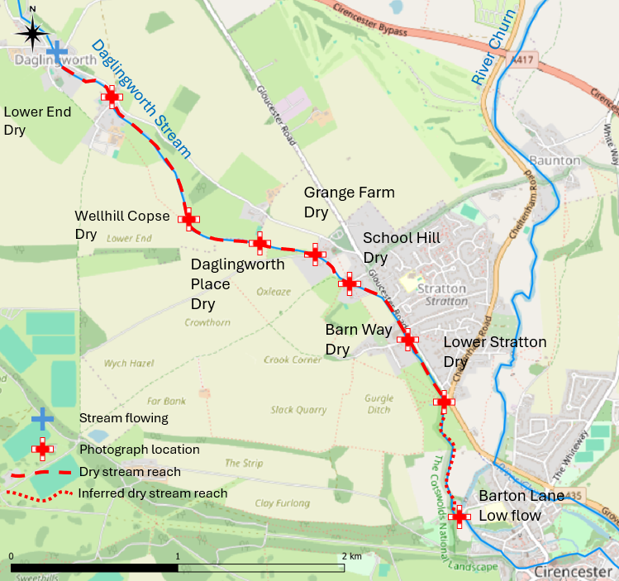
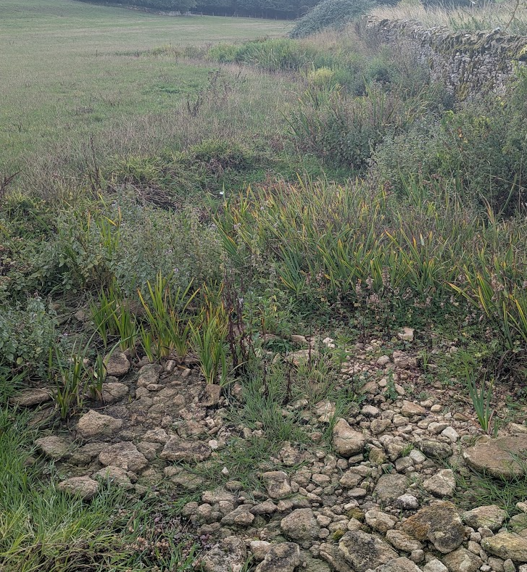
Water environment impacts
Parts of the Daglingworth Stream have been recorded as dry since the end of May 2025.
At the end of October, the Daglingworth Stream was dry for around 4 km
The stream dries regularly, but this is the longest length of dry stream recorded by FoGB
But the Churn catchment has suffered greater water stress in the past
Barton Mill Pound
Daglingworth Stream
September 2025
August 2022

Slide 6
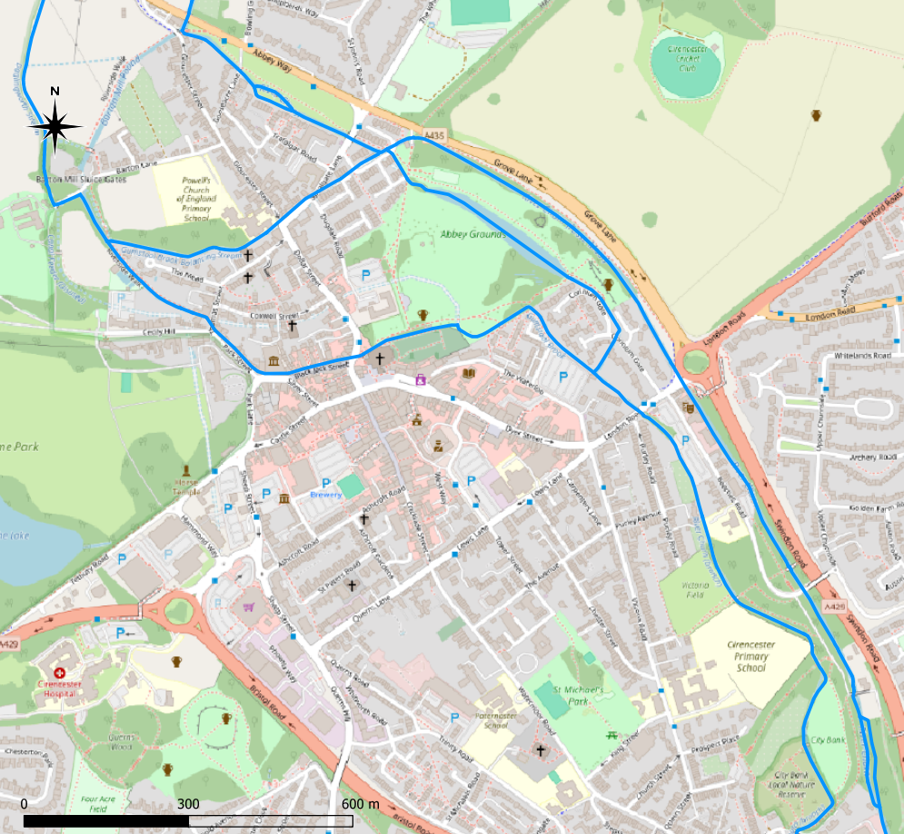
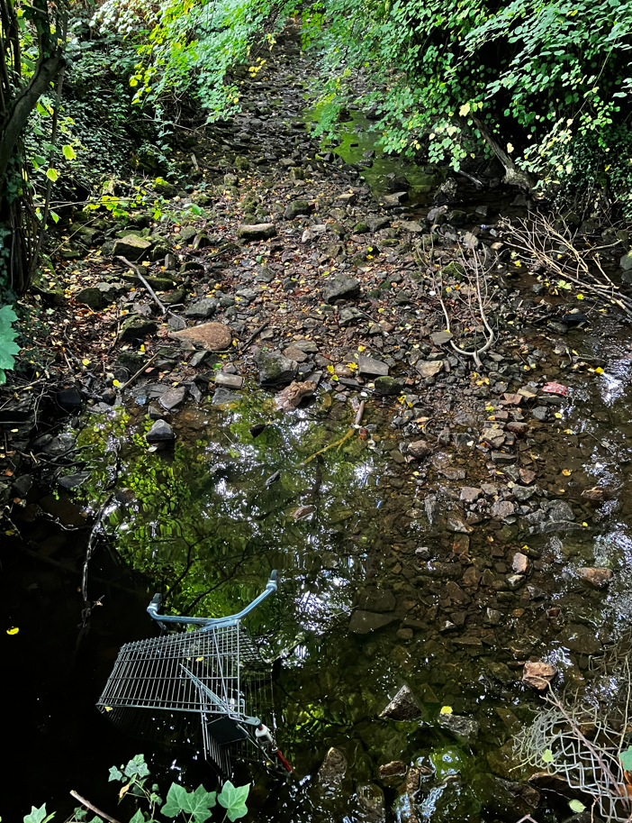
Water environment impacts
Low flows in the Churn are normal in late summer/early autumn:
  Flows >30 Ml/d are rare & <15 Ml/d is common
  Lowest 2025 flow of ~5 Ml/d occurs ~1 in 5 years
  Winter flows can exceed 200 Ml/d
Barton Mill Pound & Gumstool Brook had low flow, ponded water & dry sections in summer 2025; this is not uncommon
The eastern branch of the Churn downstream of New Mills was largely dry with ponded water in August & September 2025
Currently, there is no previous record of the Churn drying up at this location
But the Churn catchment has suffered greater water stress in the past
Barton Mill Pound
Barton Mill Pound
Balancing Stream
Gumstool Brook
Gumstool Brook
River Churn, New Mills
August 2022
Churn – West Branch
Churn – East Branch
August 2025

Slide 7
What next?
Gloucester St sluices
Potential for low flow management
Weather
What winter weather can we expect?
Need at least average monthly rainfall to sustain recovery
When will water resources improve to enable end of the Temporary Use Ban?
Monitoring
Need enhanced monitoring to help understand waterways response to water stress
Interventions
Environmental enhancements to improve resilience to dry weather & low flows
Infrastructure enhancements to enable improvements in low river flow management
Barton Mill Pound
Hereward Road
Channel junction
August 2022

Slide 8
Thank you. Any questions?
If you are interested in joining the Friends of the Gumstool Brook, you can contact us on FriendsOfGumstoolBrook@gmail.com

